Slide 1
Multilevel and Mixed Models
Presented By: Michael Remington

Slide 2
Table of contents
What is a mixed model?
Key Concepts
Fixed Effects vs. Random Effects
Hierarchical Structure of Data
Assumptions of Mixed Models
Types of Dependent Data
Theory and Model Specification
Practical Example in R
Model Evaluation
Plots
Model comparrison
https://psych252.github.io/psych252book/linear-mixed-effects-models-1.html
https://stats.oarc.ucla.edu/other/mult-pkg/introduction-to-linear-mixed-models/
https://si.biostat.washington.edu/sites/default/files/modules/IntroMM-Seattle-2019-Lecture02.pdf

Slide 3
What is a mixed model?
Mixed models, also known as multilevel models or hierarchical models, are a flexible statistical framework used to analyze data with complex structures or dependencies.
Pretty much advanced linear models
Unlike traditional regression models that assume independence among observations, mixed models explicitly account for the correlated nature of the data by incorporating both fixed and random effects.

Slide 4
Fixed vs Random Effects
Fixed Effects
Effects of explanatory variables that are of primary interest and are assumed to have consistent and replicable impacts across different contexts or populations.
Fixed effects are parameters that represent the relationship between these variables and the response variable, and we are interested in estimating these specific effects.
Examples include treatment effects in an experiment or the impact of educational interventions.
Random Effects
Are effects that come from variables that introduce variability into the model but are not the primary focus of the study.
These effects are assumed to be random samples from a larger population.
Random effects account for variations that cannot be directly modeled as fixed effects, often used to handle correlations within hierarchical or nested data structures, such as measurements within subjects or subjects within treatment groups.
Allow for individual-specific intercepts or slopes and acknowledge that the data are not independent but clustered.

Slide 5
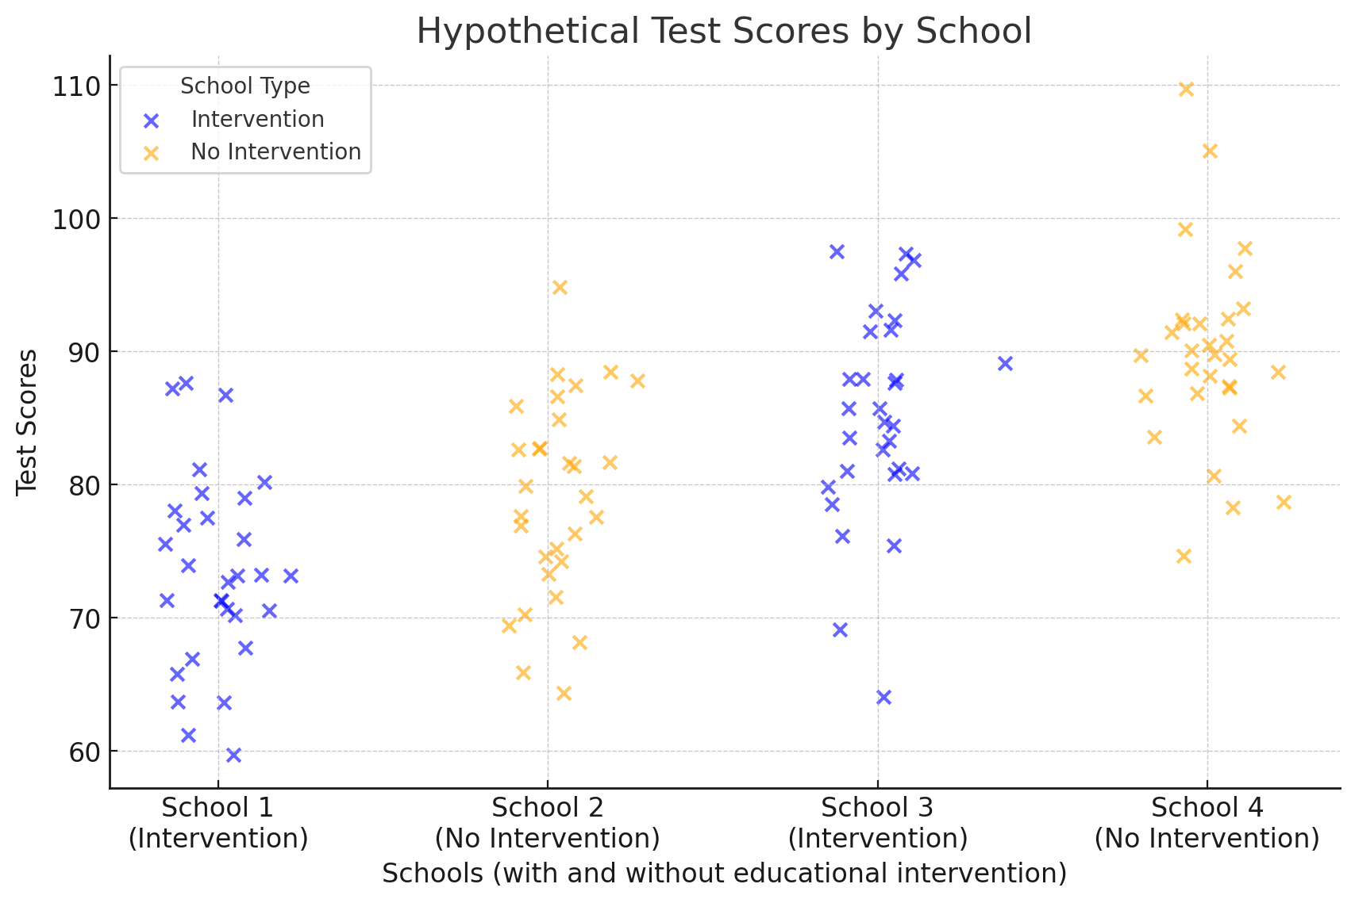
Fixed versus Random Effects (Example)
Fixed Effect
Implementing an intervention in a school to such as after school tutoring.
Random Effect
Variability among students in performance.

Slide 6
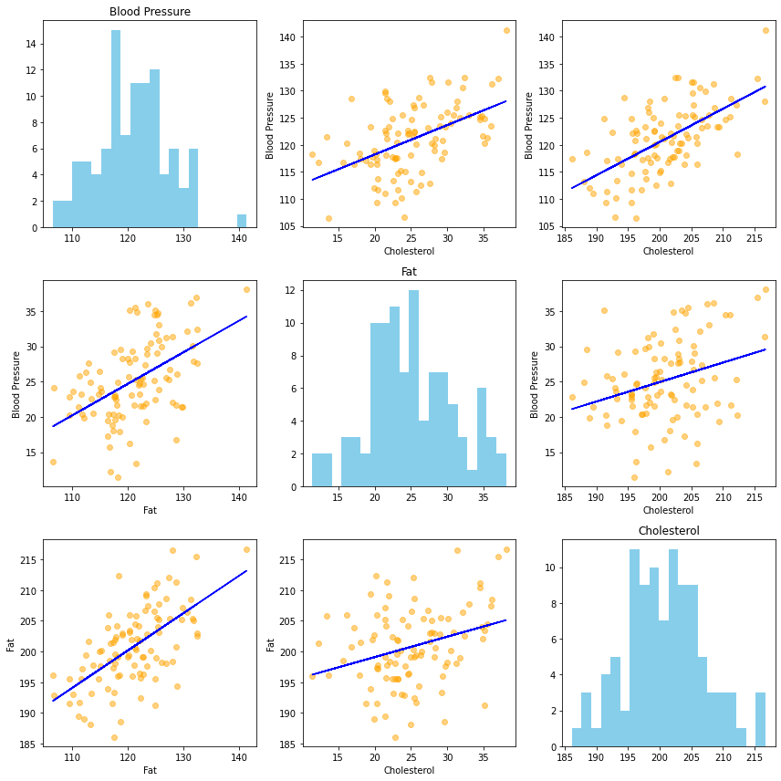
Dependent Data: Multivariate Measurements
Measurements that might be correlated
Multicollinearity
Examples
Flower petal width, length, and area
Blood pressure, Fat, Cholesteral

Slide 7
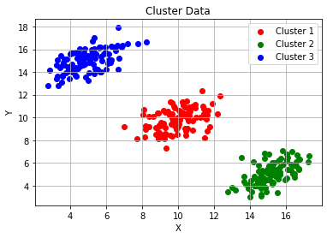
Dependent Data: Clustered Measurements
Data that is group dependent
Examples
Species
Social circles
Sports teams
Data related as groups

Slide 8
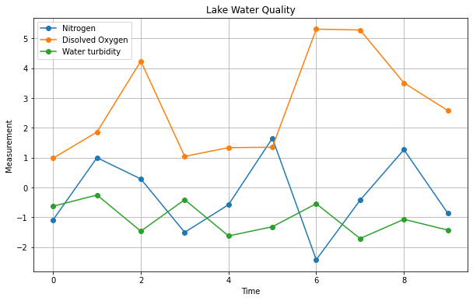
Dependent Data: Repeated Measures
Repeated measures data involve collecting multiple observations on the same subjects or units under different conditions or time points.
Temporal dependence
Multiple measurements at a field site over time

Slide 9
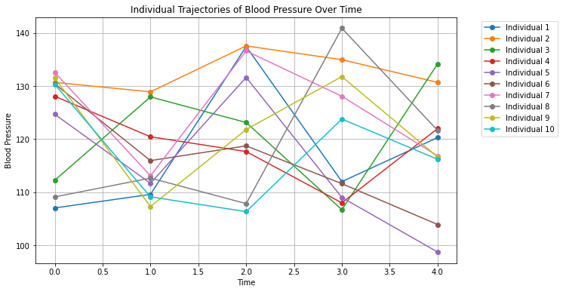
Dependent Data: Longitudinal Data
Multiple observations on the same subjects or units over an extended period
Looking at the trajectories of individuals over time

Slide 10
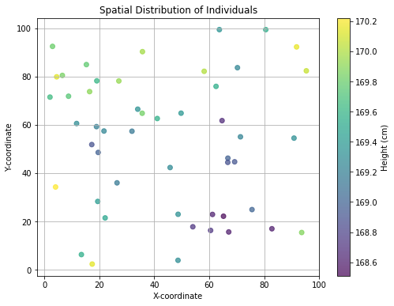
Dependent Data: Spatial Data
Multiple observations on the same subjects or units over an extended period
Looking at the trajectories of individuals over time

Slide 11
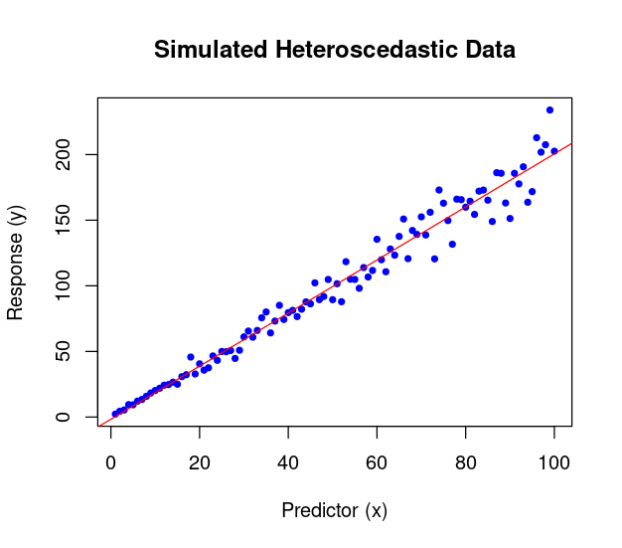
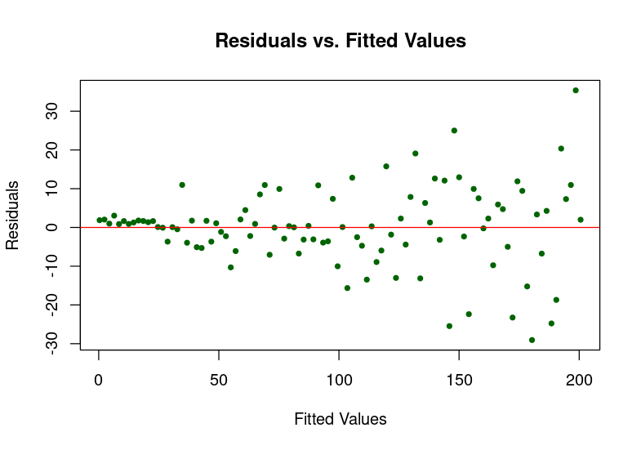
Other Signs: Heterscadacity

Slide 12
R Background

Slide 13
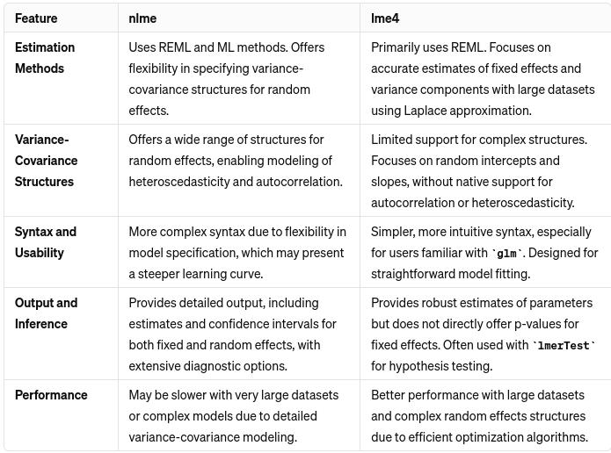
Lme4 vs nlme
Restricted Maximum Likelihood (REML): A measure for goodness of fit of a model. Try to minimize.

Slide 14
Notation: Fixed Effects
Basic notation:
response ~ fixed_effect1 + fixed_effect2
Example:
height ~ age + gender

Slide 15
Notation: Random Effects
Random intercept:
response ~ fixed_effect + (1 | random_effect)
Example:
weight ~ diet + (1 | mouse)
Random intercept and slope:
response ~ fixed_effect + (1 + fixed_effect | random_effect)
Example:
score ~ study_time + (1 + study_time | student).

Slide 16
Notation: Nested Effects
Simple nested effects:
response ~ fixed_effect + (1 | higher_level:nested_level)
Example:
yield ~ fertilizer + (1 | field:plot)

Slide 17
Notation: Crossed Random Effects
Crossed random effects:
response ~ fixed_effect + (1 | random_effect1) + (1 | random_effect2)
Example:
test_score ~ teaching_method + (1 | student) + (1 | exam)

Slide 18
Notation: Bringing it all together
Model with nested and crossed effects:
response ~ fixed_effect1 * fixed_effect2 + (1 | random_effect1) + (1 + fixed_effect1 | random_effect1/nested_effect)
Example:
growth ~ water_regime * sunlight + (1 | species) + (1 + water_regime | species:location)

Slide 19
Examples in R

